Slide 1
Bike MS
Project by : Nithyanand

Slide 2

What is this all about ?
CHALLENGE
Multiple Sclerosis or MS is a long lasting disease.
Affects the brain and spinal cord.
2.5 Million people affected worldwide.
IDEA
Bike MS participants and teams are raising
funds to reach the goal – a world free of MS

Slide 3
Questions
Who are the donors?
Who are the participants and teams taking part in the event?
What is the total amount of gift fundraised based on
the place ,years and teams?

Slide 4

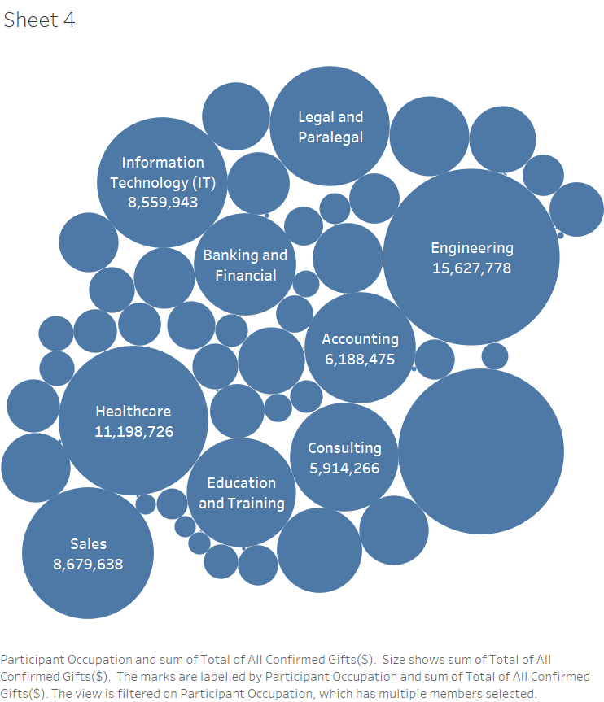
Tableau visualization
Industries which had the strongest involvement in Bike MS in the last five years and related occupations who are responsible for most of bike MS fund raising

Slide 5

Tableau visualization
What are the states where the outbreak of MS is the most and which are the areas that are donating the most?

Slide 6
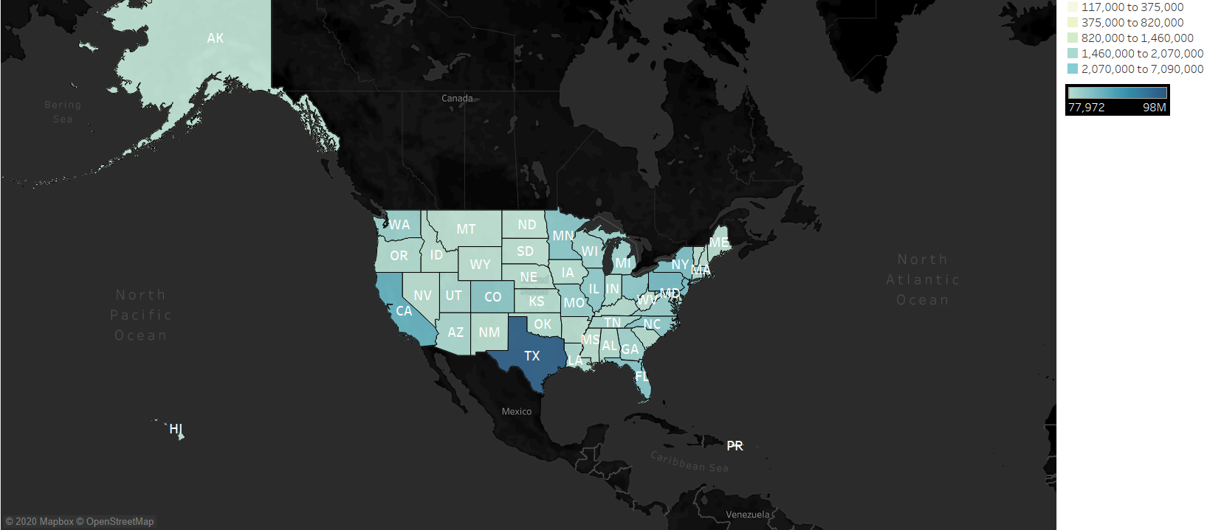
Tableau visualization
Picture shows that Texas has the highest donation amount

Slide 7
Tableau visualization
What are the states where the outbreak of MS fund raising is the high and low ?

Slide 8
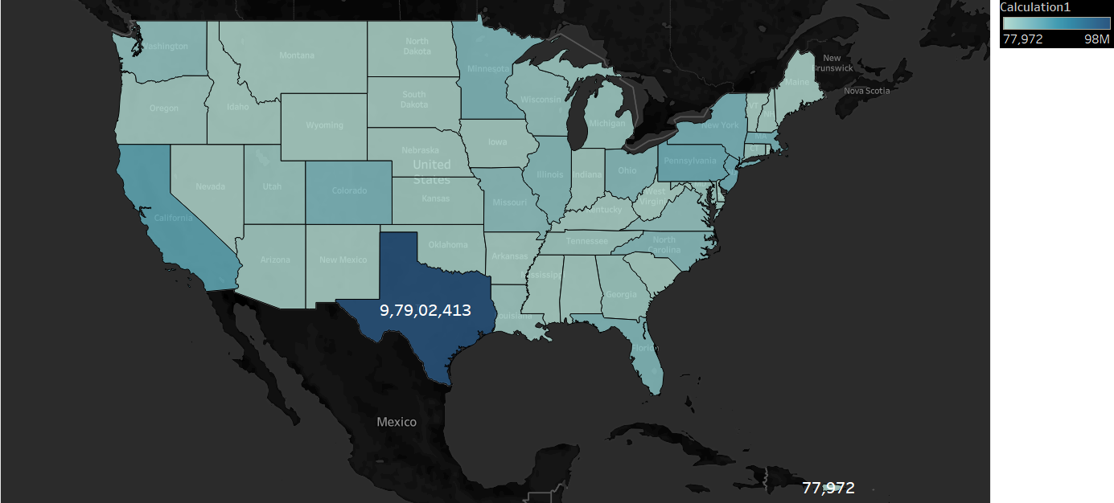
Tableau visualization
Picture shows that Texas has the highest donation and Puerto Ricans has low donation

Slide 9
Tableau visualization
Which part of US cities has participated in event and raised fund ?

Slide 10
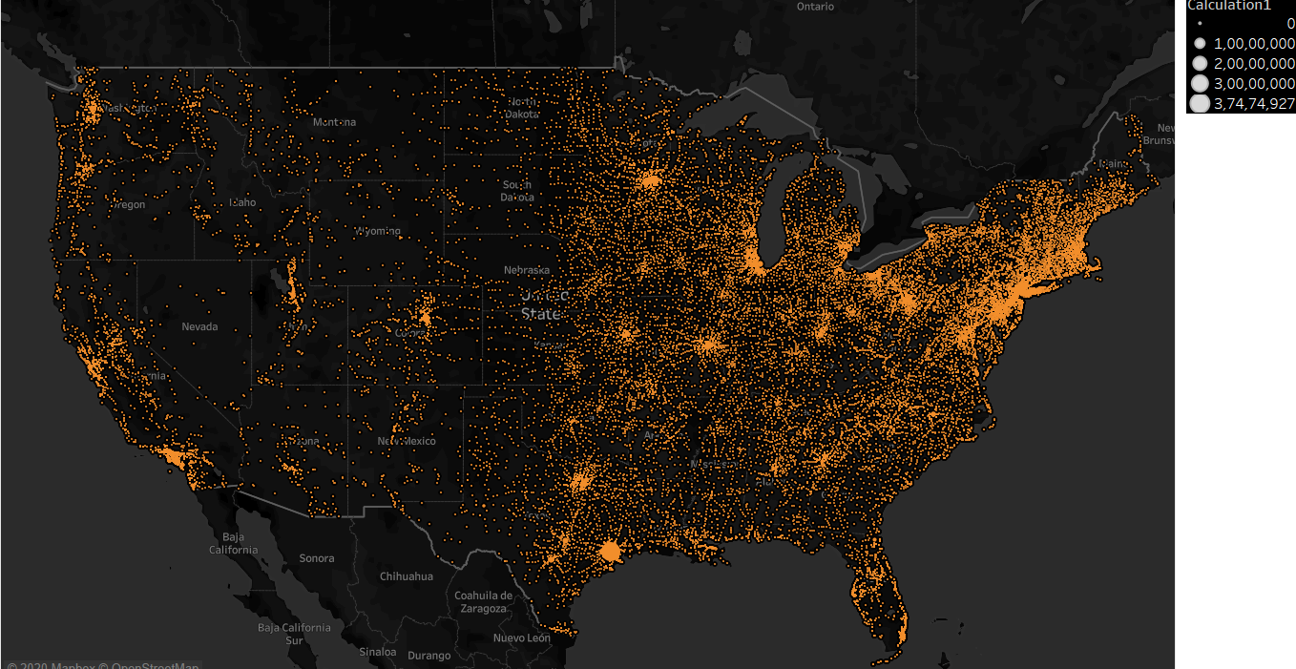
Tableau visualization
We can see that NORTH EAST and SOUTH EAST of US has most cities participated
In event and fund raising

Slide 11
Tableau visualization
What are the donations that are related to someone who have a connection with the MS disease?

Slide 12
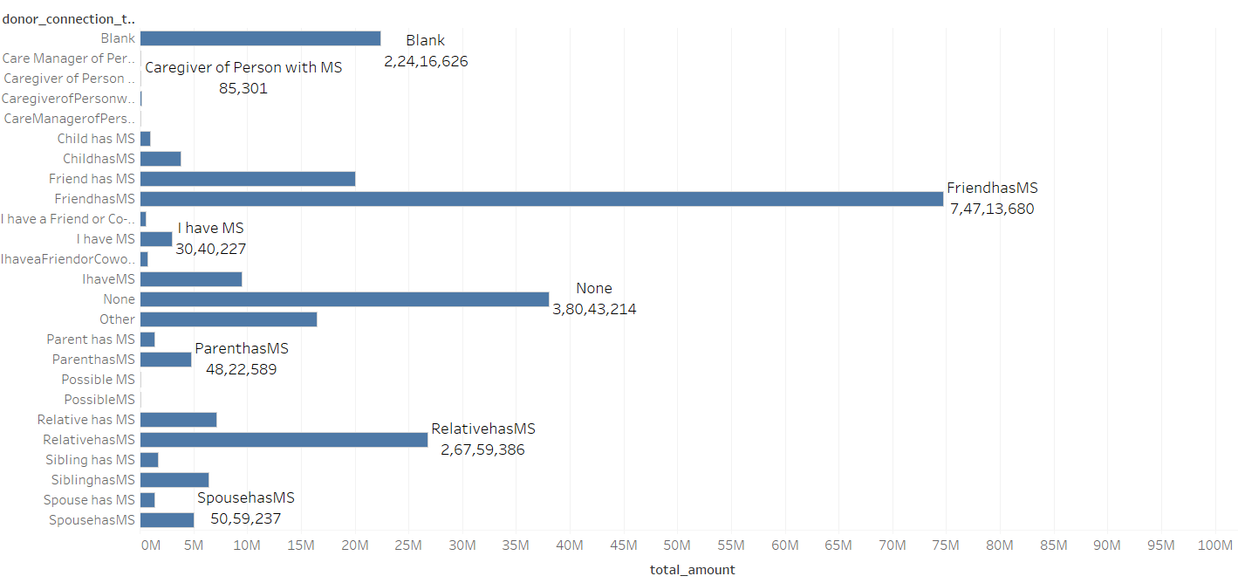
Tableau visualization
We can see that most of the donations are from donor connection to friend has MS

Slide 13
Tableau visualization
Who are the top employers who donated the fund and what are their states ?

Slide 14
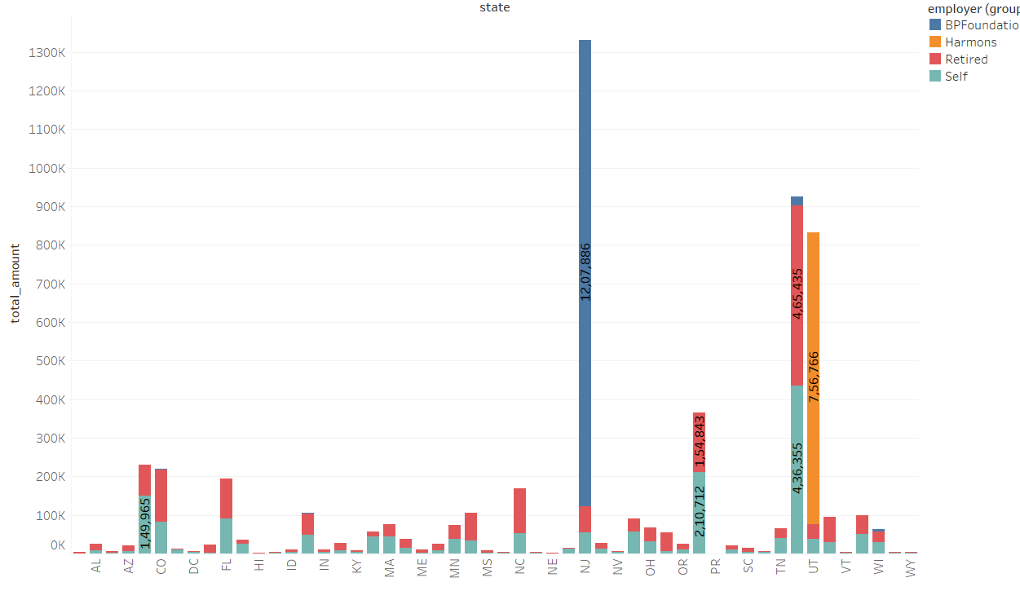
Tableau visualization

Slide 15
Tableau visualization
How many number of participants participated in event
Over 5 years (2013-2017) ?

Slide 16
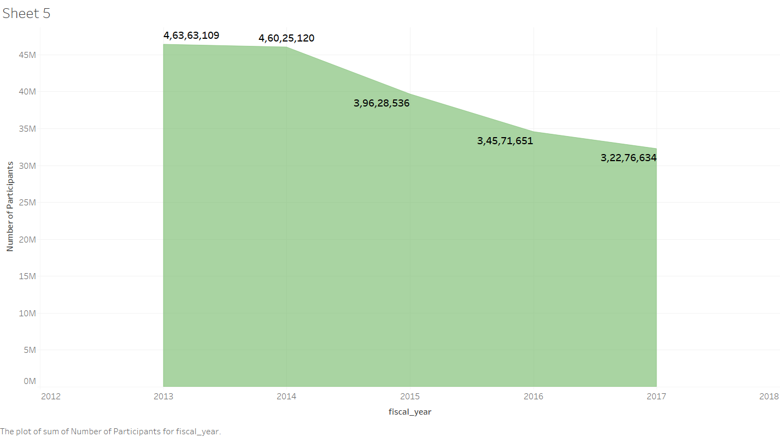
Tableau visualization

Slide 17
Tableau visualization
What is the donation total amount from participants and total amount of who are donated but not participated over 5 years ?

Slide 18
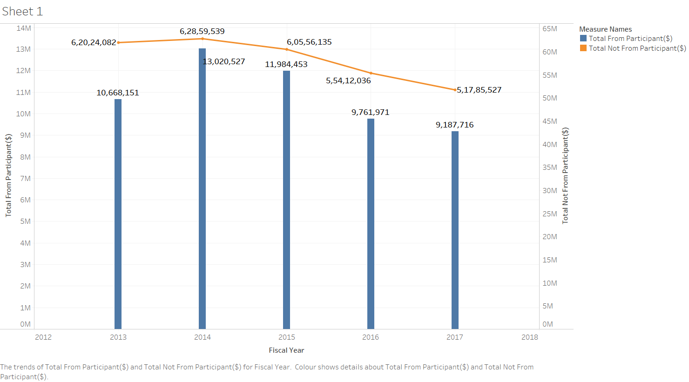
Tableau visualization

Slide 19
Tableau visualization
Which part of US cities has most participants who gave donation ?

Slide 20
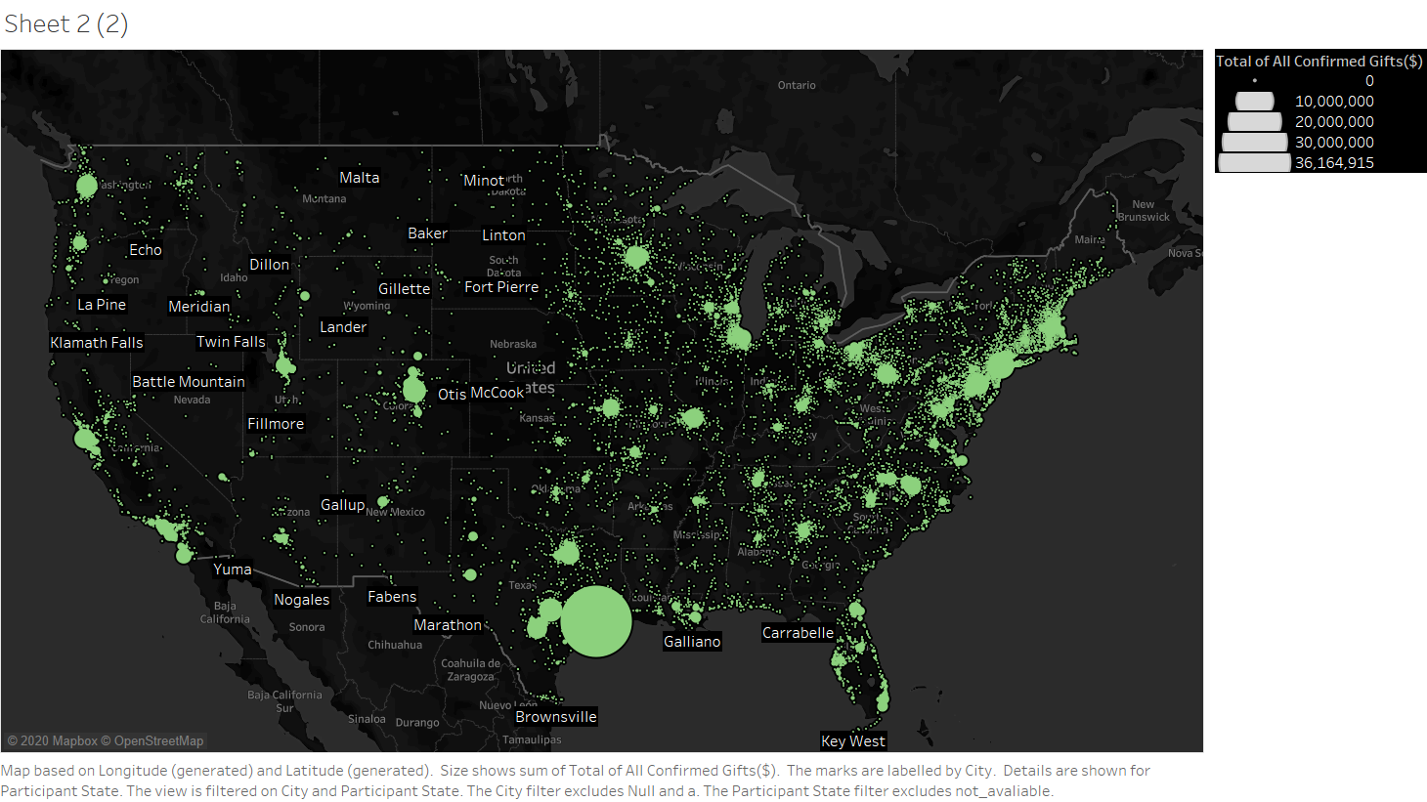
Tableau visualization

Slide 21
Tableau visualization
What is the gender of participants and who gave most of donation over 5 years and compare both male and female ?

Slide 22
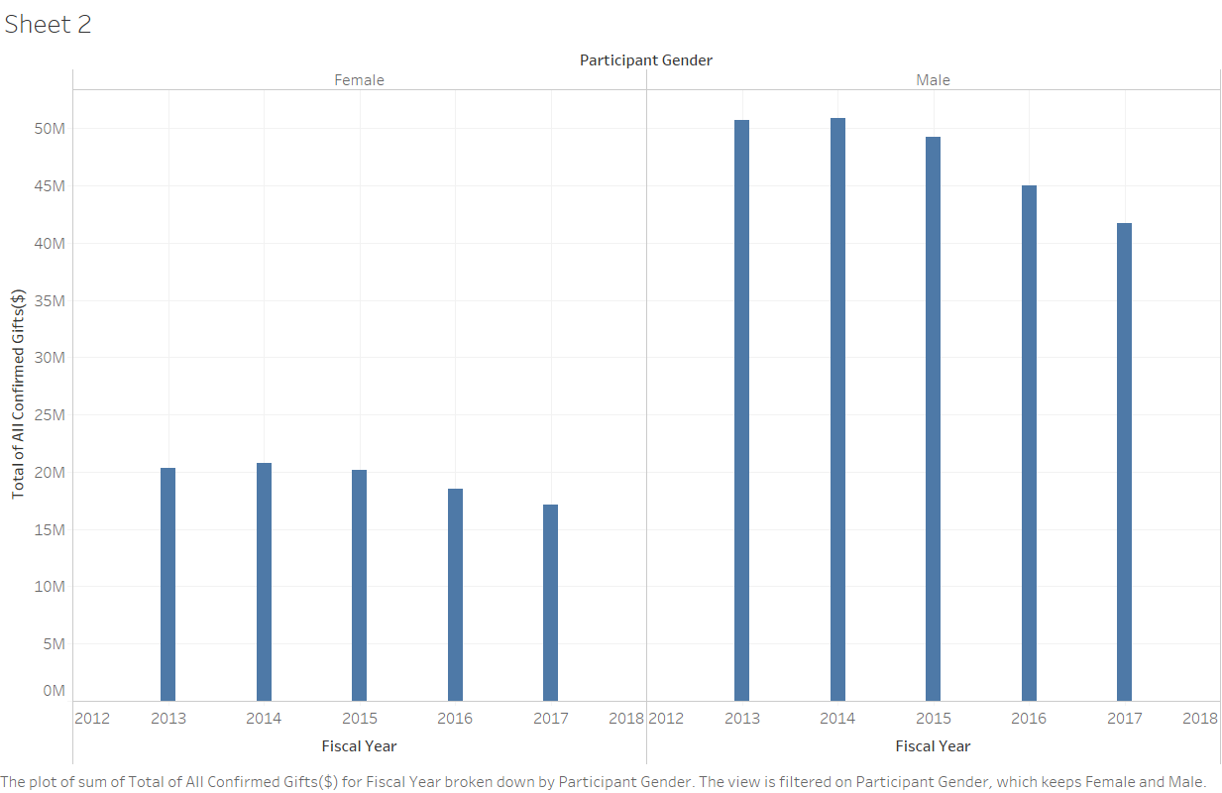
Tableau visualization

Slide 23
Tableau visualization
What is total amount of donations over 5 years?

Slide 24
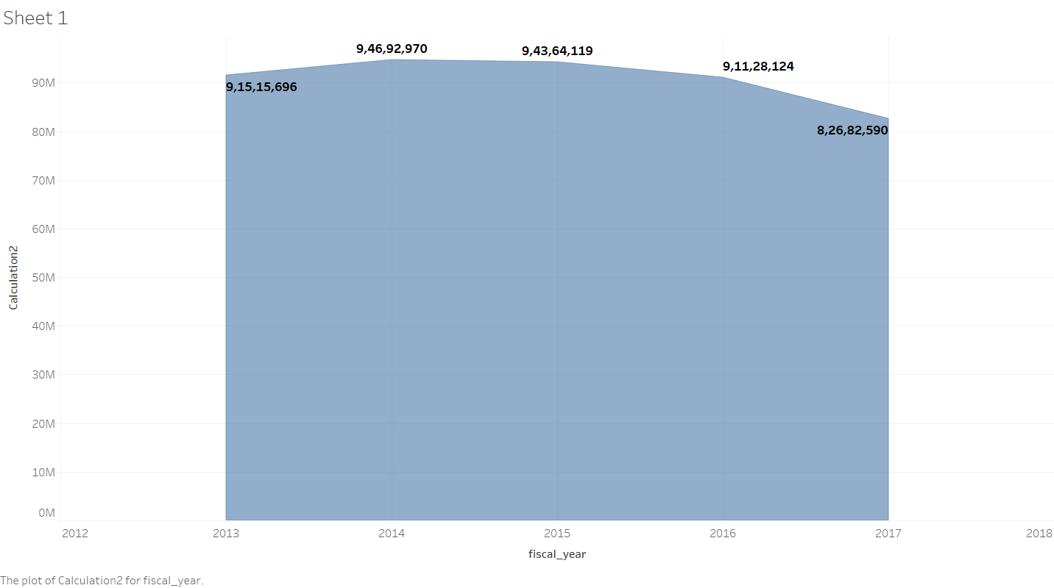
Tableau visualization

Slide 25
Tableau visualization
Which state has the highest donation amount from participant and what is the amount ?

Slide 26
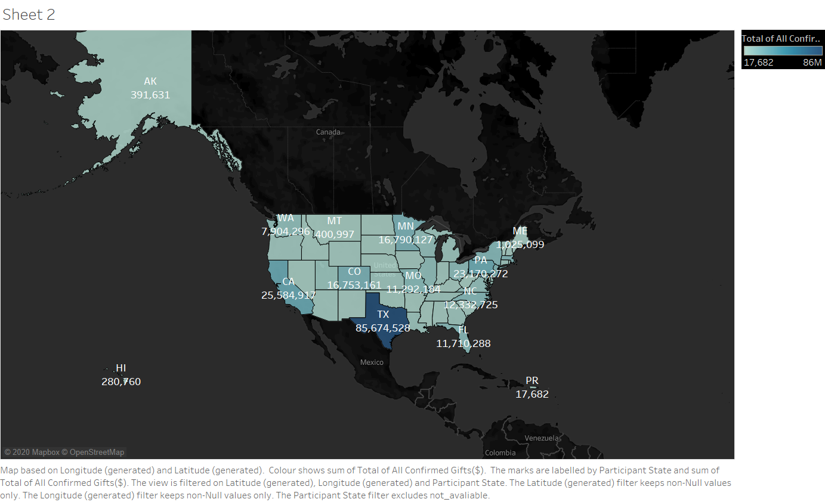
Tableau visualization

Slide 27
Tableau visualization
What is the count of participants from each state ?

Slide 28
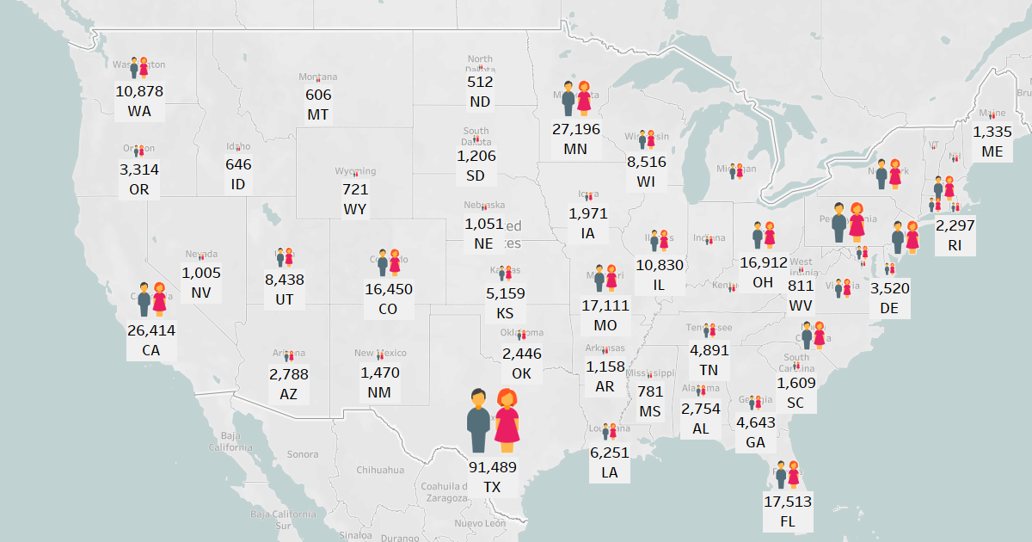
Tableau visualization

Slide 29

Data profiling and inspection
There are 6 data files: Affiliates, Bike Teams, Donations, Events, National Teams, Participants
We decided to work just in 4 datasets (the most relevant ones related to the scope of the our project) which are: BikeTeams,Donations,Events and Participants
Tools to clean data:
Excel, Tableau, PostgreSQL, Python
Identified problems with the data: missing data
duplication, irrelevant data
Improvements: Merging data (merging donation datasets from 2013- 2017) and column transformation.

Slide 30

BIG CONCEPT
Conceptual schema-DFM
Fact table: Donation
Dimensions: Year,Donor ,City,Team
Measures: Total Amount, AvgAmount(AVG)
Period:2013-2017

Slide 31

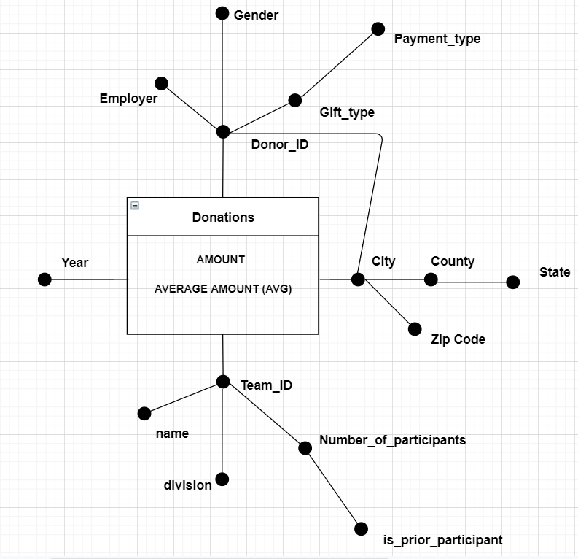
Attribute hiearchies,added measures (amount, avg amount(avg) )

Slide 32

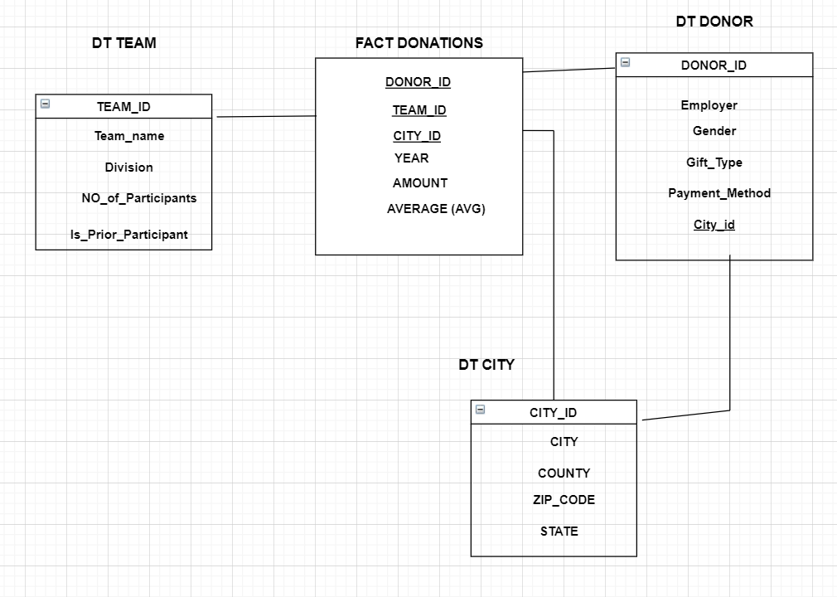
Rolap-Logical schema
FT( fact table)
DT(dimention table)
SHARED HIEARCHIES
STAR SCHEMA (IMPURE)

Slide 33

Q1. What is the total amount of donations every team(is prior participants)did per year?
OLAP
Q2. What are the cities and respective states where the majority of donations is done
Q3.What is the average amount of donations for a particular event in a given year?
Q4.What is the total amount of donations every team did based on their name and number of participants?
Q5.What is the max amount of donations and average donations based on donor’s gender per year?
Q6.What is the total amount of giving's every team did based on their name and number of participants
Q7.What are the top 5 cities and respective states where is done the majority of giving's?
Q8.What is the total amount of giving's per each type of gift(by donors) ordered by year and state ?

Slide 34



Computing cumulative totals ( window framing) net_transaction_amount
Postgresql
Computing rankings and partitioning fiscal year
Computing mobile aggregates [window framing]-mobile average

Slide 35






HIVE
Perform the same queries as in PostgreSQL
Perform 3 new other queries
H1. Retrieve the gift amount and participation type of year 2013 and who has additional caption in team
H2. what is the average gift_amount, year and donor accept email from donations of specific rows;
H3. Retrieve the employer who have donated through credit card.

Slide 36
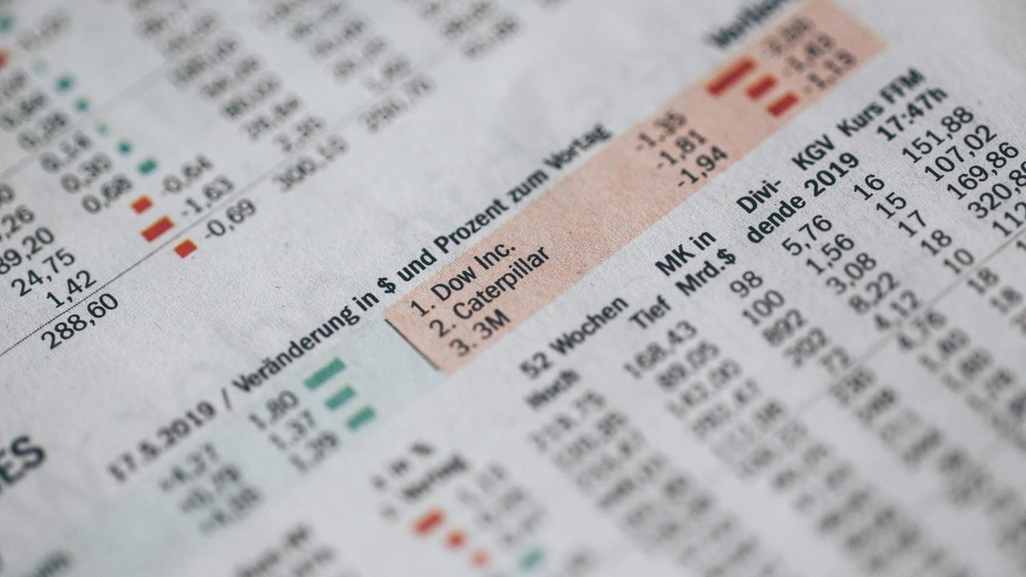


Spark dataframes and transformations
We performed OLAP queries and also 5 new queries

Slide 37
Time effort
75 hours
20 hours understanding and cleaning data
10 hours DFM, ROLAP, Queries
25 hours-hive and spark
10 hours-tableau visualization
10 hours-preparing text file and presentation

Slide 38


THANKS

